Slide 2
UNIT 2
International Business Environment
Trading Environment
Commodity Agreements
Cartels
State Trading
Trading Blocks and Growing Intra-Regional Trade
Other Regional
Groupings
SAARC
GATT/WTO and Trade Liberalization
The Uruguay Round
UNCITRAL.

Slide 3
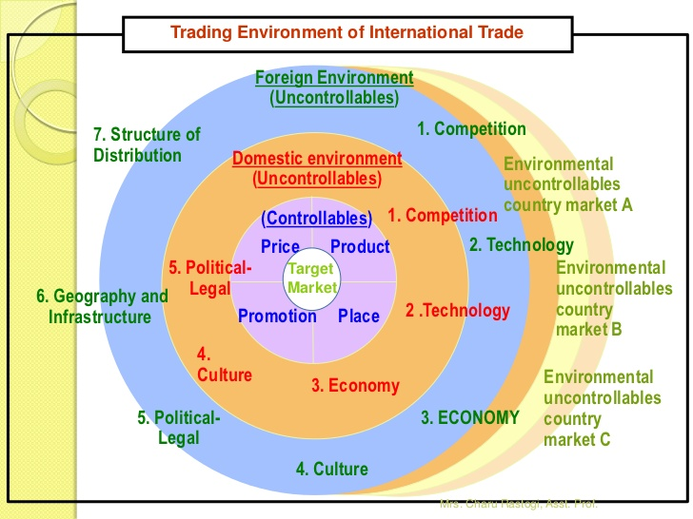

Slide 4
TRADING ENVIRONMENT
The environment of International trade is regarded as the sum total of all the external forces working upon the firm as it goes about its affairs in foreign and domestic markets.
The environment can be classified in terms of domestic, foreign and international spheres of impact.
The domestic environment is familiar to managers and consists of those uncontrollable external forces that affect the firm in its home market. However, it may be underlined that some of these forces(e.g. the cost of capital and export restrictions) can also have significant effect on global operations of a firm.
The foreign environment can be taken as those factors, which operate in those other countries within which the MNC operates. Generally, the factors are the same, but they can have widely differing impacts from the home country situation.

Slide 5
http://www.economicsdiscussion.net/international-trade/international-trading-environment-a-close-view/12957

Slide 6
Competitive in international markets is no doubt a growing challenge to private management
Developments in the international economy often impinge on domestic performance and affect national policy-making.
Have to analyze the conse­quences of developments in the global economic environment because international economic forces, national government policies, internatio­nal economic, financial and trading institutions affect management in complex and subtle ways
Foreign trade sector will become an even more dynamic sector of many national economies. More powerful in this process is the internationalization of markets, that is, the growing flow of commodities, factors of production, management technology and finan­cial capital across national borders. International trade in commercial services
— which include transportation, tourism, telecommunications, banking, insurance and various other professional services
— grew twice as fast as merchandise trade since the mid-1980s.

Slide 7
International Capital Flows:
Foreign direct investment (FDI) has also increased dramatically. International investment is undertaken not only by large companies. Small firms are also gradually becoming global enterprises in large numbers.
Many of the small com­panies now operating abroad are niche manufacturers, making specialized products whose sales often rise more rapidly overseas than at home.

Slide 8
International Transfers of Technology
The internation­al transfer of technology is often linked to foreign direct investment that brings to the host country a package of capital, management, know-how and technology
Transfer allows both product and process innovations that reduce cost per unit, improve the quality of products, and allow production of a great variety of products

Slide 9
The New International Industrial Revolution
Based on developments in science, technolo­gy and internal organization of firms and their international networks and linkages, the forces of globalization are so dramatic as to initiate a new international industrial revolution.
The consequences of this revolution are more far reaching than the introduction of the steam engine in the 18th century or railroads in the 19th century.

Slide 10
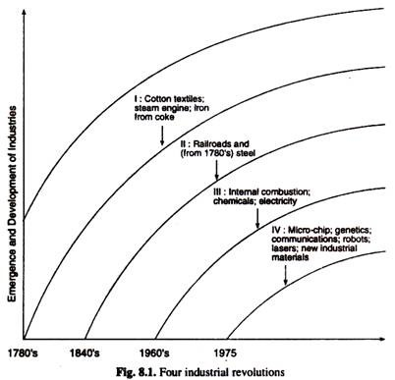

Slide 11
Commodity Agreements
Commodity agreements are arrangements between producing and consuming countries to stabilise markets and raise average prices. Such agreements are common in many markets, including the market for coffee, tea, and sugar.

Slide 12
The International Cocoa Agreement
In 2003, an agreement was made between the seven main cocoa exporting countries, Cameroon, Ivory Coast, Gabon, Ghana, Malaysia, Nigeria and Togo, and the main importing countries including the EU members, Russia, and Switzerland. The main purpose of this agreement was to promote the consumption and production of cocoa on a global basis as well as stabilize cocoa prices, which had been falling steadily. The agreement was planned to continue until 2010, but in that year it was decided to extend the agreement for a further two years, until 2012. In 2012 the signatories decided on a further extension, until 2026.
Commodity agreements often involve intervention schemes, such as buffer stocks, and usually only last for a few years, whereupon they are re-negotiated. They differ from cartels such as OPEC, largely because discussions and negotiations involve both producer and consumer countries, unlike cartels, which are established to protect the interest of producers only.

Slide 13
International Rubber Agreement
Only this agreement was negotiated under the Integrated Programme of Commodities. It was concluded on 6th October 1979 and came provisionally in force in April 1982. However, the agreement came into operational in November 1981 when the buffer stock manager started buying natural rubber in order to stabilize prolonged decline in natural rubber.
This agreement got the support of producers and consumers. Malaysia’s share was 41.5 percent, Indonesia’s 23.5 per cent and Thailand’s 13.8 per cent. There are three countries who together constitute 88 per cent of world exports. The major consumers of natural rubber are: the US -25 per cent, European Community -23 per cent and Japan – 11 per cent. The main concern of all consumers is assured supply.
Tyre manufacturers, specially those of radial tyres, needed more rubber. It was estimated that the supply of rubber would grow slowly. Further, consumers were also afraid of inflationary pressures and rise in commodity prices. It was also felt that high prices of petroleum had raised the prices of products based on petro-chemicals. Hence tyre manufacturers were keen on stable prices.
The International Natural Rubber Agreement used buffer stock operation to maintain prices at specified level. There was expected to be regular review of prices at every 18 months. Sale from buffer stock and purchase by buffer stock agency was made on the basis of stipulated price.
This agreement met with mixed success during its operation. It has managed to hold the price within the specified stabilization range despite a very severe recession in rubber demand. It is criticised that it was done at the cost of a continual accumulation of stocks.

Slide 14
International Sugar Agreement
There have been four international sugar agreements in post war period. The first one was signed in 1953, second in 1958, with a five year gap, a third agreement was signed in 1968. After a four year gap a fourth agreement was signed. Negotiation under the auspices of UNCTAD through 1983 and 1984 failed to result in any agreement. Sugar agreement operated entirely through export controls. It did not achieve much success. One of the reasons for the agreements failure was that sugar is produced by developed and developing countries. Further, holding stocks was yet another problems.
International Tin Agreement
The first year international tin agreement became operational in 1956. These agreements have subsequently renewed and sixth agreement came into force on a provisional basis. Since the US did not become a party under the agreement, the International Tin Council has intervened in the tin market both by negotiated supply restriction and through operation of buffer stock. This intervention has been considered moderately successful.

Slide 15
International Coffee Agreement
The first agreement became operational in 1963. The first agreement effectively formalized and gave consumer sanction to this arrangement. There was some rise in prices. The second agreement was terminated in 1972, the consumer export quotas was the most important instrument to stabilize prices. The fourth agreement in 1986 had many difficulties in its conclusion.
i) Renegotiation of quotas was expected to be there under which Brazil the main producer would lose its quota to the new comer such as Indonesia and African countries.
ii) US had joined this agreement for a full six years period. Yet it noted funds upto 1986.
iii) The 1985 collapse of the International Tin Agreement, together with the dramatic fall in oil prices through 1985 and 1986, have considerably reduced public confidence that international control of commodity prices is feasible.

Slide 16
International Olive Oil Agreement
In 1956 and 1963 there were International Olive Oil Agreements. In 1955, under the auspices of the U.N., 11 members participated of which 9 were exporting countries and 2 were importing countries. In 1963 7 were exporting countries and 4 were importing countries.
An International Olive Oil Council was established in 1963. The duration of the agreements of 1959 and 1963 was four years each. The Olive Oil Council was expected to make studies of the olive oil market, production, prices, etc. These agreements had price stabilization objective through price control.

Slide 17
International Wheat Agreement
In the early twenties and the thirties wheat was brought under the control of four main producers. The restrictions included those on acreage and export. The operation of the earlier wheat agreement demonstrated the need for some form of sanction to enforce compliance by participants.
There were six international wheat agreements : in 1933, 1942, 1949, 1953, 1956 and 1959. The duration of the agreements varied from failure 1942 of the agreement to 2-4 years. The major instruments of control had been export quotas and acreage restriction in the 1933 agreement. In the 1942 agreement there were more instruments and the International Wheat Council was established. Other agreements included price and buffer stock. Wheat agreement was only one multilateral contract.
To summarize, the international commodity agreements can only be successful provided that they command consensus in their industries. Consensus may emerge when a dominant leader offers leadership. The existing agreements are expected to be poorly drafted. Yet UNCTAD has continued to contribute to commodity agreements through providing information, technical assistance and convening various conferences. For example conference on tungston, olive oil, cocoa, etc. While the UNCTAD was reorganized in 1992 at its WII conference at Castegena meeting, the Committee on commodities was undisturbed. It must also be noted that this is the only international agency studying the subject with a view to stabilize the markets for primary products.

Slide 18
CARTELS
A cartel is an agreement between competing firms to control prices or exclude entry of a new competitor in a market.
It is a formal organization of sellers or buyers that agree to fix selling prices, purchase prices, or reduce production using a variety of tactics.
Cartels usually arise in an oligopolistic industry, where the number of sellers is small or sales are highly concentrated and the products being traded are usually commodities.
Cartel members may agree on such matters as setting minimum or target prices (price fixing), reducing total industry output, fixing market shares, allocating customers, allocating territories, bid rigging, establishment of common sales agencies, altering the conditions of sale, or combination of these.
The aim of such collusion (also called the cartel agreement) is to increase individual members' profits by reducing competition. If the cartelists do not agree on market shares, they must have a plan to share the extra monopoly profits generated by the cartel.
One can distinguish private cartels from public cartels. In the public cartel a government is involved to enforce the cartel agreement, and the government's sovereignty shields such cartels from legal actions.

Slide 19
Inversely, private cartels are subject to legal liability under the antitrust laws now found in nearly every nation of the world. Furthermore, the purpose of private cartels is to benefit only those individuals who constitute it, public cartels, in theory, work to pass on benefits to the populace(public) as a whole.
Competition laws often forbid private cartels. Identifying and breaking up cartels is an important part of the competition policy in most countries, although proving the existence of a cartel is rarely easy, as firms are usually not so careless as to put collusion agreements on paper.

Slide 20
The negative effects on consumers include:
Higher prices - cartel members can all raise prices together, which reduces the elasticity of demand for any single member.
Lack of transparency - members may agree to hide prices or withhold information, such as the hidden charges in credit card transactions.
Restricted output - members may agree to limit output onto the market, as with OPEC and its oil quotas.
Carving up a market - cartel members may collectively agree to break up a market into regions or territories and not compete in each other's territory.

Slide 21
When are cartels most powerful?
They are at their most powerful when there are high barriers to entry into the market or industry, and when all members can be ‘policed’ by a dominant member.
Cartel-like behavior
Some firms may act as though there is a cartel and undertake cartel-like behavior, even though there is no formal cartel, and this may be subject to investigation by the regulators.
Example:
The Siemens led electronic equipment cartel
In January 2007, the European Commission imposed a record fine of £500m on 11 European power equipment firms, led by the German firm Siemens. The Commission argued that Siemens, along with 10 other firms, had ‘carved-up’ the European power equipment market between 1988 and 2004.

Slide 22
STATE TRADING
he State Trading Corporation of India Ltd. (STC) is a premier International trading company of the Government of India engaged primarily in exports, and imports operations.
It was set up in 1956 primarily with a view to undertake trade with East European Countries and to supplement the efforts of private trade and industry in developing exports from the country.
The Corporation is registered as an autonomous company under the Companies Act, 1956 and functions under the administrative control of the Ministry of Commerce & Industry, Govt. of India.

Slide 23
The Corporation has played a key role in the Indian economy. In the pre-liberalisation era, it acted as an arm of the Government of India not only to regulate foreign trade but also for intervention in the domestic market.
The Corporation handled canalized exports and imports of large number of items varying from chemicals and drugs to bulk commodities such as edible oils, cement, sugar, newsprint, wheat, urea, etc. thereby ensuring timely availability and equitable distribution of mass consumption items as well as essential raw materials for the industry.
Canalization (Canalization is a measure of the ability of a population to produce the same phenotype regardless of variability of its environment or genotype. It is a form of evolutionary robustness.) also helped the nation to benefit from economies of scale and keeping a close watch on the scarce foreign exchange.

Slide 24
It undertook price support operations to ensure remunerative prices to growers for their crops such as raw jute, tobacco, rubber and vanilla as and when called upon by the Government to do so.
As part of its export development effort, STC extended technical, marketing and financial assistance to exporters by arranging import of machinery and raw material for export production, setting up design centre's, providing testing laboratories, taking products of small manufacturers to overseas markets by organizing their consortia, participation in exhibitions and trade fairs, etc.

Slide 25
Objectives:
To develop core competencies in selected areas and exploit the market opportunities in these areas to the best advantage of the Corporation.
To continuously undertake horizontal and vertical diversifications thereby enabling sustained growth of business.
To make best use of financial strength of the Corporation in expanding its business.
To lay emphasis on quality of services to customers so as to develop long-term business relationship with buyers and suppliers in and outside the country.
To undertake market intervention operation as and when advised by the Government of India.
To create new infrastructure and make optimum utilisation of infrastructure available with the Corporation.
To strive to pay adequate returns to the stakeholders.
To fulfil Corporation’s social responsibility by following ethical business practices and reinforcing commitment to customers, employees, partners and communities.
To undertake on a continuous basis training / re-training of existing manpower and induct professionally qualified young talent so as to create a cadre of highly professional and motivated managers.
To ensure an efficient and streamlined system of operations, with minimum transaction costs.
To act as a facilitator to small and medium exporters and importers.

Slide 26
TRADING BLOCKS AND GROWING INTRA-REGIONAL TRADE

Slide 27
A trading bloc is a group of countries which are geographically close to each other and have similar trade policies, which are can with their mutual co-operation ensure a free flow of goods among them.
Certain countries from economic unions for their mutual benefits and are known as trading blocs. Countries which have something in common have formed an economic union for mutual benefit these groups are called trading blocs.
This group of countries called trading blocs because they form the group or block for trading purpose. They facilitate a trade to member countries of the group but create barriers and block of non-members countries.
Trading blocs are the associations of countries situated in the particular region whereby they come to a common understanding about rules and regulations to be followed while exporting and importing goods among them. Such groups have liberal rules for members countries and a separate set of rules for non-members.
For Example – European union ( EU) , The association of south-east Asian nations ASEAN. Trading Bloc is a group of countries catering into an agreement to create conditions that can give encouragement to trade among the group. Trading blocs are called international Economic groupings are established by many countries after the second world war. Trading blocs enhance the market size. Total Demand for goods and services overall productivity, employment and economic activity in the region and people of the get different types of products at comparatively lower prices.

Slide 28
Trade Bloc
A trade bloc is a type of intergovernmental agreement, often part of a regional intergovernmental organization, where regional barriers to trade, (tariffs & non-tariff barriers) are reduced or eliminated among the participating states.
A regional trading bloc is a group of countries within a geographical region that protect themselves from imports from non-members. A trade bloc is basically a free-trade zone, or near-free-trade zone, formed by one or more tax, tariff, & trade agreements between two or more countries.
The Trading blocs are a form of economic integration, & increasingly shape the pattern of the world trade. Regional trade blocks promote the trade within the block & defend its members against global competition.
Defense against global competition is obtained through established tariffs on goods produced by member states, import quotas, government subsidies, onerous bureaucratic import processes, & technical & other non-tariff barriers. Since trade is not an isolated activity, member states within regional blocks also cooperate in economic, political, security, climatic, & other issues affecting the region.
Members of successful trade blocs usually share four common traits: similar levels of per capita GNP, geographic proximity, similar or compatible trading regimes, & political commitment to the regional organization. Advocates of the worldwide free trade are usually opposed to the trading blocs, which they argue & encourage regional trade as opposed to the global free trade.

Slide 29
Objectives of Trading blocs:
To remove or reduce the trade barriers among the member countries of the group and thus create a common Market for member countries.
To maintain better economic, political, cultural and social relations among the member nations.
To impose common external Tariff and non-tariff barriers on Non – member countries.
To promote the free transfer of labor capital and other factors of productive and bring integration of economies of member countries.
To create a common currency and central bank for the countries of the group.

Slide 30
Positive impacts of trading blocs:
Economic integration.
Co-operative spirit .
Expansion of markets .
Growth and development of the regions.
Uniform policies .
An increase in trade.
Product and market development.
Free transfer of resources.
Negative effects of Trading blocs:
Common external barriers.
Collective bargaining by member nations.
Affect competition.
Affects global / International trade.
Problems for non–members.
Loss of political sovereignty.

Slide 31
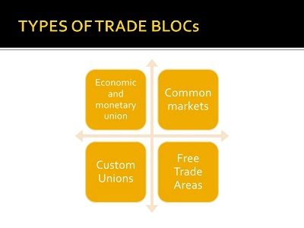

Slide 32
Types of Trading Blocs
Trade blocs can be stand-alone agreements between several states (such as the North American Free Trade Agreement (NAFTA) or part of a regional organization (such as the European Union). Depending on the level of an economic integration, the trade blocs can fall into the 6 different categories, such as preferential trading areas, the free trade areas, the customs unions, the common markets, the economic union & the monetary unions, & the political union.
Preferential Trade Area: Preferential Trade Areas (PTAs) exist when countries within a geographical region agree to reduce or eliminate tariff barriers on selected goods imported from other members of the area. This is often the first small step towards the creation of a trading bloc.
Free trade area: Free Trade Areas (FTAs) are created when 2 or more countries in a region agree to reduce or eliminate barriers to trade on all the goods coming from other members. This is the most basic form of economic cooperation. Member countries remove all barriers to trade between themselves but are free to independently determine trade policies with nonmember nations. An example is North American Free Trade Agreement (NAFTA).

Slide 33
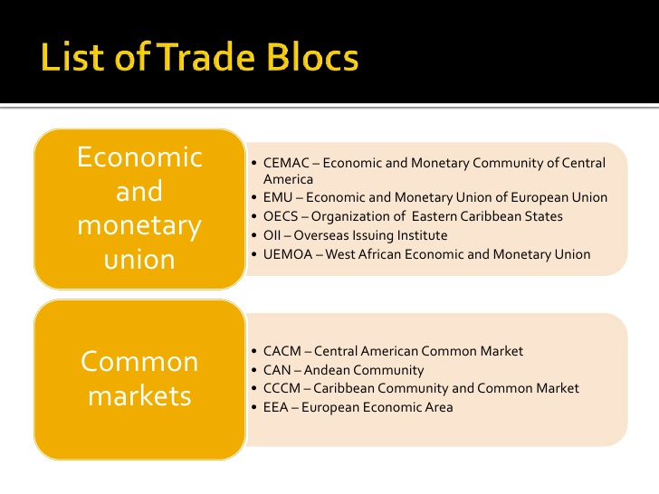

Slide 34
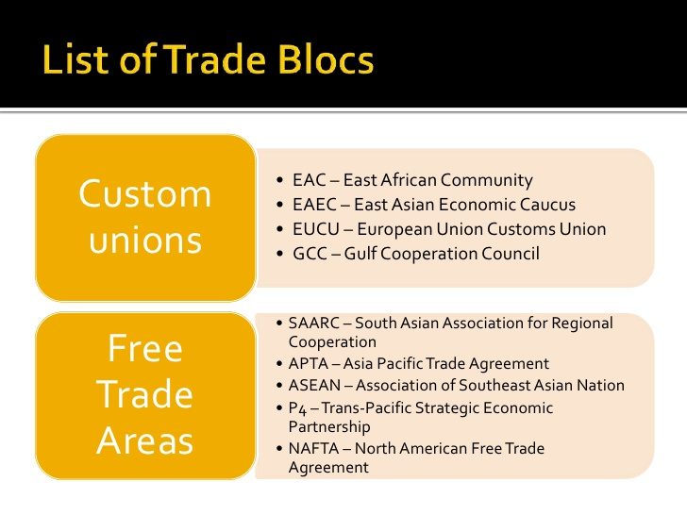

Slide 35
Customs union: This type provides for economic cooperation as in a free-trade zone. Barriers to trade are removed between member countries. The primary difference from the free trade area is that members agree to treat trade with non-member countries in a similar manner. The customs union involves the removal of the tariff barriers among the members, as well as the acceptance of the common (unified) external tariff in contradiction to the non-members. This means that the members may negotiate as a single bloc with third parties, such as with other trading blocs, or with the WTO. The Gulf Cooperation Council (GCC) Cooperation Council for the Arab States of the Gulf is an example.

Slide 36
Common market:
A ‘common market’ is the first significant step towards full economic integration, & occurs when member countries trade freely in all economic resources – not just tangible goods.
This means that all barriers to trade in goods, services, capital, & labor are removed. In addition, as well as removing tariffs, non-tariff barriers are also reduced & eliminated. For a common market to be successful there must also be a significant level of harmonization of macroeconomic policies, & common rules regarding monopoly power & other anti-competitive practices.
There may also be common policies affecting key industries, such as the Common Agricultural Policy (CAP) & Common Fisheries Policy (CFP) of the European Single Market (ESM). This type allows for the creation of economically integrated markets between member countries.
Trade barriers are removed, as are any restrictions on the movement of labor & capital between member countries. Like customs unions, there is a common trade policy for trade with nonmember nations.
The primary advantage to the workers is that they no longer need the visa or work permit to work in another member country of the common market. An example is the Common Market for Eastern & Southern Africa (COMESA).

Slide 37
Economic & monetary union: This type is created when countries enter into an economic agreement to remove barriers to trade & adopt common economic policies. An example is the European Union (EU). Monetary union is a type of trade bloc which is composed of an economic union (common market & customs union) with a monetary union. Monetary union is established through a currency-related trade pact. An intermediate step between pure monetary union & a complete economic integration is the fiscal union. Economic & Monetary Union of the European Union with the Euro for the Euro-zone members is the example of monetary union.
Political union: In order to be successful the more advanced integration steps are typically accompanied by the unification of economic policies (tax, social welfare benefits, etc.), reductions in the rest of the trade barriers, introduction of the supranational bodies, & gradual moves towards the final stage, a “political union”. Political union is a final stage in the economic integration with more formal political links among the countries. A limited form of the political union may exist when two or more countries share common decision-making bodies & have common policies. It is the unification of previously separate nations. The unification of West & East Germany in 1990 is an example of the total political union.

Slide 38
Advantages
Free trade within the bloc: Knowing that they have free access to each other’s markets, members are encouraged to specialize. This means that, at a regional level, there is the wider application of the principle of the comparative advantage.
Market access & trade creation: Easier access to each other’s markets means that trade between members is likely to increase. Trade creation exists when free trade enables high-cost domestic producers to be replaced by lower cost, & more efficient imports. Because low-cost imports lead to lower-priced imports, there is a ‘consumption effect’, with increased demand resulting from lower prices. These agreements create more opportunities for countries to trade with one another by removing the barriers to trade & investment. Due to a reduction or removal of tariffs, cooperation results in cheaper prices for consumers in the bloc countries.

Slide 39
Economies of scale: Producers can benefit from the application of scale economies, which will lead to lower costs & lower prices for consumers.
Jobs: Jobs may be created as the consequence of increased trade among the member economies. By removing the restrictions on labor movement, the economic integration can help expand the job opportunities.
Protection: Firms inside the bloc are protected from cheaper imports from outside, such as the protection of the EU shoe industry from cheap imports from China & Vietnam.
Consensus & cooperation: Member nations may find it easier to agree with smaller numbers of countries. Regional understanding & similarities may also facilitate closer political cooperation.

Slide 40
DISADVANTAGES
Loss of benefits: The benefits of the free trade among the countries in different blocs is lost.
Distortion of trade: Trading blocs are likely to distort world trade, & reduce the beneficial effects of specialization & the exploitation of comparative advantage.
Inefficiencies & trade diversion: Inefficient producers within the bloc can be protected from more efficient ones outside the bloc. For example, the inefficient European farmers could be protected from the low-cost imports from the developing countries. Trade diversion arises when the trade is diverted away from efficient producers who are based outside the trading area. The flip side to trade creation is trade diversion. The member countries may trade more with each other than with nonmember nations. This might mean increased trade with the less efficient or more expensive producer because it is in the member country. In this sense, weaker companies can be protected inadvertently with the bloc agreement acting as a trade barrier. In essence, the regional agreements have formed new trade barriers with countries outside of the trading block.

Slide 41
Retaliation: The development of 1 regional trading bloc is likely to stimulate the development of others. This can lead to the trade disputes, such as those between the EU & NAFTA, including the recent Boeing (US)/ Airbus (EU) dispute. The EU & US have a long history of the trade disputes, together with the dispute over US steel tariffs, which were declared illegal by the WTO in 2005.
Employment shifts & reductions: Countries may move production to cheaper labor markets in member countries. Similarly, workers may move to gain access to better jobs & wages. Sudden shifts in the employment can tax the resources of the member countries.

Slide 42
Growing Intra-regional trade
an Intra- Within or inside
Regional – Belonging to or characteristics
of geographic region
Trade – The activity of buying and selling.

Slide 43
Growing Intra-regional trade
The intra-regional trade had been formed by the economic integration schemes of the trading bloc. Some people view world trade as board comprising of the Intra-regional trade and the Interregional Trade and this is also been named as the Regionalization and Globalization of the world trade. The share of the Intra-regional trade in the total world trade increased in the 1980’s in western Europe , North America, and Asia . In other words, Trade within the region substantially is faster than world trade.. in 1990 the intra-regional trade was accounted for about 61% of the total trade in goods of the European community.
The corresponding Figures were 41% of Asia and 35% for North America . over 60% of Trade of the Pacific, via nations stays within the areas.
Regional integration schemes tend to increase the Intra-regional Trade. For example trade among the 12 members of the EC increased from about 40% in the year 1960 to 60% in the year 1990.

Slide 44
Intra-regional trade has also increased in the EFTA and ASEAN. There is a worldwide trend towards forming new regional arrangements and strengthening existing ones. Inspired by the EEC example several regional integrations schemes have been formed by the developing countries, particularly in the Latin America and Africa. However, none of them is a commendable success.
By late 1970’s outward oriented policies have begun to capture the imagination of the policy makers. The years that followed unilaterally, non discriminating trade liberalization became the order of the day regionalism was pushed to the background. The situation, however, was changed by the end of the 1980’s and today regionalism is back with a Vengeance.

Slide 45
The rise of intra-Asian regional trade
There has been a surge in intra-regional trade within Asian countries
The share has grown from 42 per cent in 1990 to 52 per cent in 2011 – now a majority of trade
Most of the change is due to a fall in the share of North America in total Asian trade
Many Asian countries have achieved fast progress towards a highly diversified industrial base.
Increasing capacities and competencies in producing many different goods and services has accelerated intra-industry trade e.g. as countries supply different components.
Asia is building complex and large supply chains and trading more within the region as a result

Slide 46

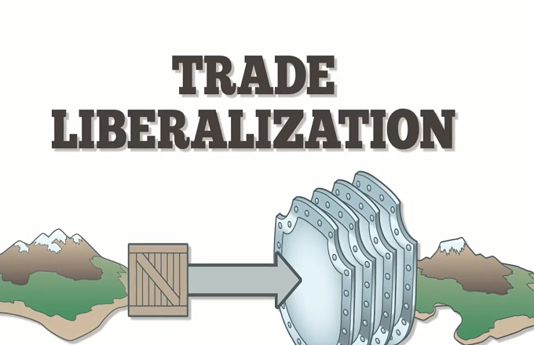
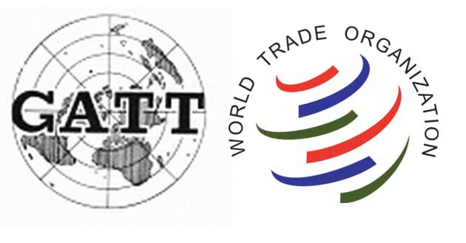

Groupings

Slide 47
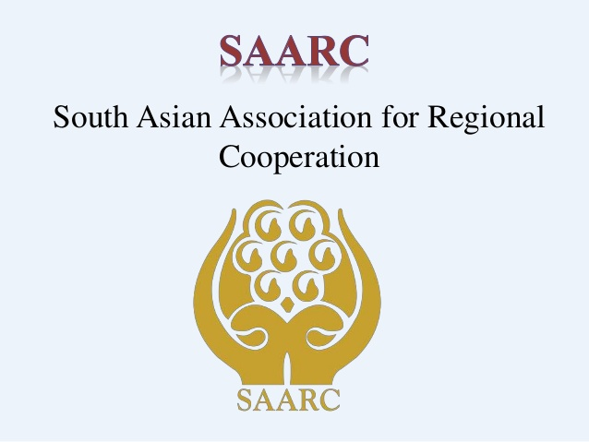
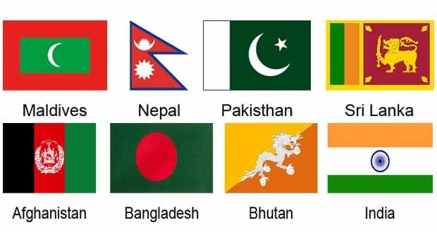

Slide 48
The South Asian Association for Regional Cooperation (SAARC) was established with the signing of the SAARC Charter in Dhaka on 8 December 1985.
SAARC comprises of eight Member States:
Afghanistan,
Bangladesh,
Bhutan,
India,
Maldives,
Nepal, Pakistan
and Sri Lanka.
The Secretariat of the Association was set up in Kathmandu on 17 January 1987.

Slide 49
Objectives
To promote the welfare of the peoples of South Asia and to improve their quality of life;
To accelerate economic growth, social progress and cultural development in the region and to provide all individuals the opportunity to live in dignity and to realize their full potentials;
To promote and strengthen collective self-reliance among the countries of South Asia;
To contribute to mutual trust, understanding and appreciation of one another's problems;
To promote active collaboration and mutual assistance in the economic, social, cultural, technical and scientific fields;
To strengthen cooperation with other developing countries;
To strengthen cooperation among themselves in international forums on matters of common interests;
To cooperate with international and regional organizations with similar aims and purposes.

Slide 50
Charter of the South Asian Association for Regional Cooperation
We, the Heads of State or Government of BANGLADESH, BHUTAN, INDIA, MALDIVES, NEPAL, PAKISTAN and SRI LANKA;
1. Desirous of promoting peace, stability, amity and progress in the region through strict adherence to the principles of the UNITED NATIONS CHARTER and NON- ALIGNMENT, particularly respect for the principles of sovereign equality, territorial integrity, national independence, non-use of force and non-interference in the internal affairs of other States and peaceful settlement of all disputes;
2. Conscious that in an increasingly interdependent world, the objectives of peace, freedom, social justice and economic prosperity are best achieved in the SOUTH ASIAN region by fostering mutual understanding, good neighborly relations and meaningful cooperation among the Member States which are bound by ties of history and culture;
3. Aware of the common problems, interests and aspirations of the peoples of SOUTH ASIA and the need for joint action and enhanced cooperation within their respective political and economic systems and cultural traditions;
4. Convinced that regional cooperation among the countries of SOUTH ASIA is mutually beneficial, desirable and necessary for promoting the welfare and improving the quality of life of the peoples of the region;

Slide 51
5. Convinced further that economic, social and technical cooperation among the countries of SOUTH ASIA would contribute significantly to national and collective self- reliance;
6. Recognizing that increased cooperation, contacts and exchanges among the countries of the region will contribute to the promotion of friendship and understanding among their peoples;
7. Recalling the DECLARATION signed by their Foreign Ministers in NEW DELHI on August 2, 1983 and noting the progress achieved in regional cooperation;
8. Reaffirming their determination to promote such cooperation within an institutional framework;

Slide 52
SAARC SUMMITS
The Meetings of the Heads of State or Government of Member States is the highest decision making authority under SAARC. Summits are usually held biennially hosted by a Member State in alphabetical order. The Member State hosting the Summit assumes the Chair of the Association.
The key outcome of a SAARC Summit is a Declaration. The Summit Declaration contains decisions and directives of the Leaders to strengthen and consolidate regional cooperation in different areas being pursued under the auspices of SAARC.
The Declaration is adopted by the Leaders at the concluding session of a Summit.
The Summit also considers and approves reports of the Council of Ministers and Ministerial Meetings. During the Summit, policy statements on regional cooperation under SAARC are made by the Leaders. The Summit is also addressed by Heads of Observer delegations and by the Secretary General.

Slide 53
S.No | Location | Date of Summit
1 | Dhaka | 7-8 December, 1985
2 | Bangalore | 16-17 November, 1986
3 | Kanthmandu | 2-4 November, 1987
4 | Islamabad | 2-31 December, 1988
5 | Male' | 21-23 November, 1990
6 | Colombo | 21 December, 1991
7 | Dhaka | 10-11 April, 1993
8 | New Delhi | 2-4 May, 1995
9 | Male' | 12-14 May, 1997
10 | Colombo | 29-31 July, 1998
11 | Kathmandu | 4-6 January, 2002
12 | Islamabad | 2-6 January, 2004
13 | Dhaka | 12-13 November, 2005
14 | New Delhi | 3-4 April, 2007
15 | Colombo | 1-3 August, 2008
16 | Thimphu | 28-29 April, 2010
17 | Addu | 10-11 November, 2011
18 | Kathmandu | 26-27 November 2014

Slide 54
SAARC APEX BODIES
1 | SAARC Chamber of Commerce & Industry (SCCI)
2 | South Asian Association for Regional Cooperation in Law (SAARCLAW)
3 | South Asian Federation of Accountants (SAFA)
4 | South Asia Foundation (SAF)
5 | Foundation of SAARC Writers and Literature (FOSWAL)
6 | South Asia Initiative to End Violence Against Children (SAIEVAC)

Slide 55
SAARC RECOGNIZED BODIES
1 | Association of Management and Development Institutions in South Asia (AMDISA)
2 | South Asian Association for Regional Cooperation of Architects (SAARCH)
3 | Federation of State Insurance Organizations of SAARC Countries (FSIO)
4 | SAARC Diploma Engineers Forum (SDEF)
5 | Radiological Society of SAARC Countries (RSSC)
6 | SAARC Teachers Federation (STF)
7 | SAARC Surgical Care Society (SSCS)
8 | South Asia Free Media Association (SAFMA)
9 | SAARC Women’s Association (SWA)
10 | Hindukush Himalayan Grassroots Women’s Natural Resources Management (HIMAWANTI)
11 | Federation of Association of Pediatric Surgeons of SAARC Countries (FAPSS)
12 | South Asian Federation of Exchanges (SAFE)
13 | SAARC Federation of Oncologists (SFO)
14 | South Asia Association of National Scout Organization (SAANSO)
15 | South Asian Network of Economic Research Institute (SANEI)
16 | SAARC Academy of Ophthalmology (SAO)
17 | South Asian Women Development Forum (SAWDF)
18 | Self Employed Women Association (SEWA)

Slide 56
Achievements of SAARC
1. South Asian Free Trade Area SAFTA
A Free Trade Agreement confined to goods, but excluding all services like information technology. Agreement was signed to reduce customs duties of all traded goods to zero by the year 2016.
2. SAPTA
South Asia Preferential Trading Agreement for promoting trade amonst the member countries came into effect in 1995.
3. SAARC visa exemption decided that certain categories of dignitaries should be entitled to a Special Travel document, which would exempt them from visas within the region.
4. Greater cultural co-operation
5. Advantages of Least Developed Countries
It has provided forum for bilateral and regional agreements to the small poor nations for collaboration among themselves for development.

Slide 57
Limitations of SAARC
1. Domination of India
India has 70% area amongst all SAARC countries. Also remaining small countries does not share border with each others except for Pakistan- Afghanistan.
2. Political differences
The political differences had deep negative impact on the political will to realize the economic cooperation and integration.
3. Inequality among members
The member states except India have still not reached the take-off stage to be able to pursue the program of economic integration and collaboration.

Slide 58
4. The South Asia Preferential Trading Agreement (SAPTA) was signed in the 7th summit at Dhaka in April 93, but it has not yet been operationalized. The proposal to establish South Asian Food Reserve and South Asian Development Fund have also met the same fate. Similarly declarations on enhancing political cooperation and promotion of mutual trust and understanding reiterated in each summit have registered limited success.
5. SAARC charter excludes bilateral and contentious issues discussion on forum
6. Obstructionist policies of Pakistan has created problems in economic cooperation
7. No progress in road and rail connectivity which is obstacle for trade.
8. Most of the countries are poor except for India and lack full fledged democratic structure.

Slide 59
GATT/WTO and Trade Liberalization

Slide 60
Multilateral agreements after World War II
The conclusion of World War II spurred efforts to correct the problems stemming from protectionism, which had increased since 1871, and trade restrictions, which had been imposed between World Wars I and II.
The resulting multilateral trade agreements and other forms of international economic cooperation led to the General Agreement on Tariffs and Trade (GATT) and laid the foundation for the World Trade Organization (WTO).

Slide 61
Bretton Woods System and 1944 Agreement
How Bretton Woods Introduced a New World Order
he Bretton Woods system was a remarkable achievement of global coordination. It established the U.S. dollar as the global currency, taking the world off of the gold standard. It created the World Bank and the International Monetary Fund. These two global organizations would monitor the new system.
Bretton Woods established America as the dominant power behind these two organizations and the world economy.
That's because it replaced the gold standard with the U.S. dollar. After the agreement was signed, America was the only country with the ability to print dollars.

Slide 62
The Bretton Woods Agreement
The Bretton Woods agreement was created in a 1944 conference of all of the World War II Allied nations. It took place in Bretton Woods, New Hampshire. Under the agreement, countries promised that their central banks would maintain fixed exchange rates between their currencies and the dollar. How exactly would they do this? If a country's currency value became too weak relative to the dollar, the bank would buy up its currency in foreign exchange markets. That would decrease the supply, which would raise the price. If its currency became too high, the bank would print more. That would increase the supply and lower its price.
Members of the Bretton Woods system agreed to avoid any trade warfare. For example, they wouldn't lower their currencies strictly to increase trade.
But they could regulate their currencies under certain conditions. For example, they could take action if foreign direct investment began to destabilize their economies. They could also adjust their currency values to rebuild after a war.

Slide 63
The Collapse of the Bretton Woods System
In 1971, the United States was suffering from massive stagflation(persistent high inflation combined with high unemployment and stagnant demand in a country's economy.). That's a deadly combination of inflation and recession. It was partly a result of the dollar's role as a global currency. In response, President Nixon started to deflate the dollar's value in gold. Nixon revalued the dollar to 1/38 of an ounce of gold, then 1/42 of an ounce.
But the plan backfired. It created a run on the U.S. gold reserves at Fort Knox as people redeemed their quickly devaluing dollars for gold. In 1973, Nixon unhooked the value of the dollar from gold altogether. Without price controls, gold quickly shot up to $120 per ounce in the free market. The Bretton Woods system was over.
https://www.thebalance.com/bretton-woods-system-and-1944-agreement-3306133

Slide 64
GATT/WTO and Trade Liberalization
General Agreement on Tariffs and Trade (GATT), set of multilateral trade agreements aimed at the abolition of quotas and the reduction of tariff duties among the contracting nations.
When GATT was concluded by 23 countries at Geneva, in 1947 (to take effect on Jan. 1, 1948), it was considered an interim arrangement pending the formation of a United Nations agency to supersede it.
When such an agency failed to emerge, GATT was amplified and further enlarged at several succeeding negotiations.
It subsequently proved to be the most effective instrument of world trade liberalization, playing a major role in the massive expansion of world trade in the second half of the 20th century.
By the time GATT was replaced by the World Trade Organization (WTO) in 1995, 125 nations were signatories to its agreements, which had become a code of conduct governing 90 percent of world trade.

Slide 65
GATT’s most important principle was that of trade without discrimination, in which each member nation opened its markets equally to every other. As embodied in unconditional most-favoured nation clauses, this meant that once a country and its largest trading partners had agreed to reduce a tariff, that tariff cut was automatically extended to every other GATT member.
GATT included a long schedule of specific tariff concessions for each contracting nation, representing tariff rates that each country had agreed to extend to others. Another fundamental principle was that of protection through tariffs rather than through import quotas or other quantitative trade restrictions; GATT systematically sought to eliminate the latter.
Other general rules included uniform customs regulations and the obligation of each contracting nation to negotiate for tariff cuts upon the request of another. An escape clause allowed contracting countries to alter agreements if their domestic producers suffered excessive losses as a result of trade concessions.

Slide 66
Trade Liberalization
Trade liberalization involves removing barriers to trade between different countries and encouraging free trade.
Trade liberalization involves:
Reducing tariffs
Reducing/eliminating quotas
Reducing non-tariff barriers.
Non-tariff barriers are factors that make trade difficult and expensive. For example, having specific regulations on making goods can give an unfair advantage to domestic producers. Harmonizing environmental and safety legislation makes it easier for international trade.

Slide 67
Advantages of Trade Liberalization
Comparative advantage. Trade liberalization allows countries to specialize in producing the goods and services where they have a comparative advantage (produce at lowest opportunity cost). This enables a net gain in economic welfare.
Lower prices. The removal of tariff barriers can lead to lower prices for consumers. E.g. removing food tariffs in West would help reduce the global price of agricultural commodities. This would be particularly a benefit for countries who are importers of food.

Slide 68
Increased competition. Trade liberalization means firms will face greater competition from abroad. This should act as a spur to increase efficiency and cut costs, or it may act as an incentive for an economy to shift resources into new industries where they can maintain a competitive advantage. For example, trade liberalization has been a factor in encouraging the UK to concentrate less on manufacturing and more on the service sector.
Economies of scale. Trade liberalization enables greater specialization. Economies concentrate on producing particular goods. This can enable big efficiency savings from economies of scale.
Inward investment. If a country liberalizes its trade, it will make the country more attractive for inward investment. For example, former Soviet countries who liberalize trade will attract foreign multinationals who can produce and sell closer to these new emerging markets. Inward investment leads to capital inflows but also helps the economy through diffusion of more technology, management techniques and knowledge.

Slide 69
Problems of Trade Liberalization
Structural unemployment. Trade liberalisation often leads to a shift in the balance of an economy. Some industries grow, some decline. Therefore, there may often be structural unemployment from certain industries closing. Trade liberalisation can often be painful in the short run, as some industries and some workers suffer from the decline in uncompetitive firms. Though net economic welfare improves, it can be difficult to compensate those workers who lose out to international competition.
Environmental costs. Trade liberalisation could lead to greater exploitation of the environment, e.g. greater production of raw materials, trading toxic waste to countries with lower environmental laws.
Infant-industry argument. Trade liberalisation may be damaging for developing economies who cannot compete against free trade. The infant industry argument suggests that trade protection is justified to help developing economies diversify and develop new industries. Most economies had a period of trade protectionism. It is unfair to insist that developing economies cannot use some tariff protectionism. Because of this argument, some argue that trade liberalisation often benefits developed countries more than developing countries.

Slide 70
The Uruguay Round
Multilateral trade agreements are commerce treaties between three or more nations. The agreements reduce tariffs and make it easier for businesses to import and export. Since they are among many countries, they are difficult to negotiate.
The Marrakesh Agreement, manifested by the Marrakesh Declaration, was an agreement signed in Marrakesh, Morocco, by 124 nations on 15 April 1994, marking the culmination of the 8-year-long Uruguay Round and establishing the World Trade Organization, which officially came into being on 1 January 1995
The Uruguay Round was the 8th round of Multilateral Trade Negotiations (MTN) conducted within the framework of the General Agreement on Tariffs and Trade (GATT), spanning from 1986 to 1994 and embracing 123 countries as "contracting parties". The negotiations and process ended with the signing of the Final Act of the Marrakesh Agreement in April 1994 at Marrakesh, Morocco. The round led to the creation of the World Trade Organization (WTO), with GATT remaining as an integral part of the WTO agreements.

Slide 71
The Uruguay Round was, without a doubt, the largest trade negotiation ever, and may very well have been the largest negotiation ever. It set out rules and principles to cover all global trade, from banking to consumer products.
The subjects for negotiations, the widest of any GATT round, were tariffs, non-tariff measures, tropical products as a priority area, natural resource-based products, textiles and clothing, agriculture, review of GATT articles, safeguards, Tokyo Round agreements ad arrangements, subsidies and countervailing measures, dispute settlement, trade-related aspects of intellectual property rights, trade-related investment measures and the Functioning of the GATT System (FOGS).

Slide 72
The main achievements of the Uruguay Round included:
1- A trade-weighted average tariff cut of 38%;
2- Conclusion of the Agreement on Agriculture which brought agricultural trade for the first time under full GATT disciplines;
3- Adoption of the General Agreement of trade in Services (GATS);
4- The Agreement on Trade-Related Aspects of Intellectual Property Rights (TRIPS);
5- The Agreement on Trade-Related Investment Measures (TRIMS);
6- The creation of unified and predictable dispute settlement mechanism (Dispute Settlement Body-DSB);
7- Confirmation f the trade Policy Review Mechanism (TPRM);
8- The establishment of the WTO, which administers 15 multilateral, and four plurilateral trade agreements;
The Uruguay Round had extended considerably the realm of world trade rules with agreements on intellectual property and trade in services in ex-change for finally tackling agricultural protectionism on a broader scale and getting rid of the textile and clothing quotas.

Slide 73
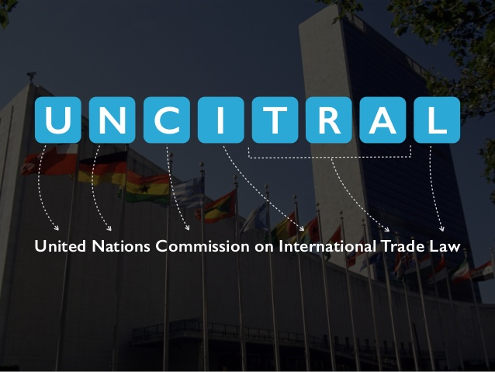

Slide 74
THE UNITED NATIONS COMMISSION ON INTERNATIONAL TRADE LAW (UNCITRAL)
The United Nations Commission on International Trade Law (UNCITRAL) is a subsidiary body of the General Assembly of the United Nations which was established in 1966 with the general mandate to further the progressive harmonization and unification of the law of international trade.
UNCITRAL has since prepared a wide range of conventions, model laws and other instruments dealing with the substantive law that governs trade transactions or other aspects of business law which have an impact on international trade.

Slide 75
"Harmonization" and "unification" of the law of international trade refers to the process through which the law facilitating international commerce is created and adopted.
The United Nations Commission on International Trade Law identifies areas in which international commerce is hindered due to factors such as lack of a predictable governing law, out-of-date laws not easily applicable to contemporary commercial practice, inter alia, and then carefully crafts solutions which are acceptable to States having different legal systems and levels of economic and social development.

Slide 76
While the terms are closely interrelated, "harmonization" may conceptually be thought of as the process through which domestic laws may modified to enhance predictability in cross-border commercial transactions; and "unification" may be seen as the adoption by States of a common legal standard governing particular aspects of international business transactions.
A model law or a legislative guide is an example of a text which is drafted to harmonize domestic law, while a convention is an international instrument which is adopted by States for the unification of the law at an international level.
Texts resulting from the work of UNCITRAL include conventions, model laws, legal guides, legislative guides, rules, and practice notes.

Slide 77
Who participates in the drafting of UNCITRAL texts?
UNCITRAL texts are initiated, drafted, and adopted by the United Nations Commission on International Trade Law, a body made up of elected member States representing different geographic regions. Participants in the drafting process include member States of the Commission and other States (referred to as "observer States").
Observer States may participate actively in the drafting process. In addition, interested international inter- governmental organizations ("IGO's") and non-governmental organizations ("NGO's") may participate.

Slide 78
What are the regional groups represented within the Commission and who are the member States within each region?
There are five regional groups represented within the Commission. Their names, and the States elected to the Commission are as follows:
African States - Benin, Burkina Faso, Cameroon, Kenya, Morocco, Rwanda, Sierra Leone, Sudan and Uganda;
Asian States - China, Fiji, India, Iran (Islamic Rep. of), Japan, Singapore, and Thailand;
Eastern European States - Hungary, Lithuania, Romania, Russian Federation,
The former Yugoslav Republic of Macedonia; Latin American and
Caribbean States - Argentina, Brazil, Colombia, Honduras, Mexico, Paraguay and Uruguay;
Western European and Other States - Austria, Canada, France, Germany, Italy, Spain, Sweden, United States of America and United Kingdom.

Slide 79
What is a "Working Group"?
A "Working Group" is a subset of the Commission that, as the name implies, works on a particular topic such as arbitration or transport law.
Working Groups, with the assistance of the Secretariat, draft UNCITRAL texts for the consideration of the Commission.

Slide 80
How are decisions taken at UNCITRAL?
UNCITRAL typically takes decisions by consensus, rather than by voting.

Slide 81
http://www.uncitral.org
http://www.libertas-institut.com/de/MK/International_Materials/UNCITRAL%20generally.pdf

